Slide 1

EVALUATION OF SECURITY ATTACKS USING PENETRATION TESTING
GOWRI ADDEPALLI(01)
LAKSHMI ADDEPALLI(02)
HARSHA JESHNANI(22)
D17A

Slide 2
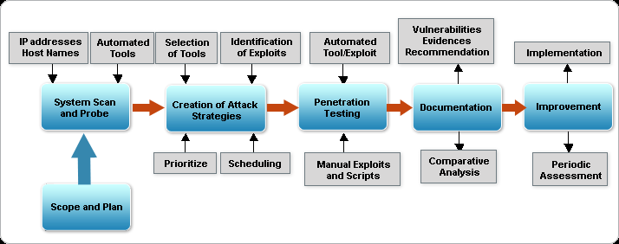
PROBLEM DEFINITION
A penetration test is a proactive and authorized attempt to evaluate the security of an IT infrastructure by safely attempting to exploit system vulnerabilities, including OS, service and application flaws, improper configurations, and even risky end-user behavior. Such assessments are also useful in validating the efficacy of defensive mechanisms, as well as end-users’ adherence to security policies.

Slide 3
So in this mini project we attempt to illustrate four attacks to explore the points of exposure namely:
Developing a malicious botnet that exploits end user behaviour.(BOTNET attack)
Session Hijacking
Denial of Service Attack(DOS)
Automated SQL injection using SQLMAP
We use kali Linux, a Debian Distribution designed for Digital Forensics and Penetration Testing, an exclusive Operating System with comes with preconfigured technological tools to perform such attacks.

Slide 4
SESSION HIJACKING: It is the exploitation of a valid computer session to gain unauthorized access to information/services usually through web applications.The HTTP cookies used to maintain a session on many websites can easily stolen by an attacker with access to the saved cookies on victim’s computer.
AUTOMATING SQL INJECTION WITH SQLMAP: SQL injection is a type of web application security vulnerability in which an attacker is able to submit a database sql command that is executed by a web application,exposing the back-end database.Sqlmap is an open source penetration testing tool that automates the process of detecting and exploiting SQL injection flaws and taking over of database servers.It helps in database fingerprinting,over data fetching from database,accessing the underlying file system and execution commands on operating systems.
DOS ATTACK: It is an attempt to make a machine or network resource unavailable to its intended users.Although the means,motives and targets vary it consists to temporarily or indefinitely interrupt or suspend services of a host connected to the internet.
BOTNET ATTACK: Botnet is formed from the words ‘robot’ and ‘network’.Hackers use special trojans/viruses to breach the security of several computers by taking the control over to deliver a large scale cyberattack like DDOS/ E-mail spamming etc.

Slide 5


SOFTWARE AND HARDWARE REQUIREMENTS
WINDOWS ⅞, 64 bit, 4GB RAM
VIRTUALBOX
KALI LINUX-64 bit, 1GB RAM
WIRESHARK
NETWORK MINER
XAMPP
PYTHON
WI-FI ROUTER

Slide 6
EXISTING SYSTEM AND PROPOSED SYSTEM
For past decades no particular methods were in use,it was mainly brute force attacks or a circle of hackers doing it outside the industry. Nowadays,Industries after understanding the importance of security,they are now investing in methodologies to find exploits before itself so as not to face losses in future.
The proposed system for penetration testing should follow the steps described below:
1. Research information about the target system:Computers that can be accessed over the internet must have an official IP address. Freely accessible databases provide information about the IP address blocks assigned to an organization.
2. Scan target systems for services on offer:An attempt is made to conduct a port scan of the computer(s) being tested, open ports being indicative of the applications assigned to them.

Slide 7
3.Identify systems and applications:
The names and version of operating systems and applications in the target systems can be identified by “fingerprinting”.
4.Researching Vulnerabilities:
Information about vulnerabilities of specific operating systems and applications can be researched efficiently using the information gathered.
5.Exploiting vulnerabilities:
Detected vulnerabilities can be used to obtain unauthorized access to the system or to prepare further attacks.

Slide 8
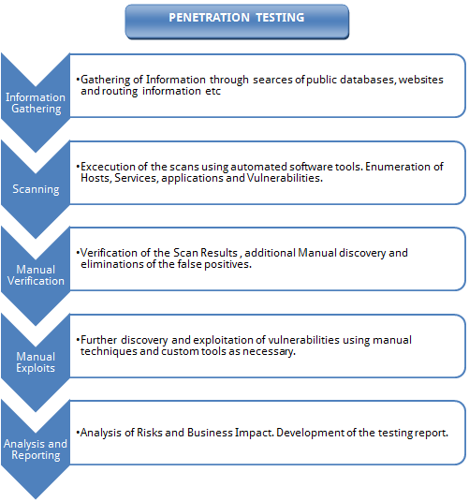

Slide 9
METHODOLOGIES
BOTNET ATTACK: For botnet attack we wrote a python script that on knowing the user credentials automatically visits various profiles in linkedin without the actual user knowing about it.It used libraries as BeautifulSoup and Selenium to scrape the web data.
Selenium is a library that interfaces and controls a web driver for browsers like Firefox and chrome for web automation.
BeautifulSoup is a library designed to make interacting with html easier, supporting finding and selecting specific html tags. Used BeautifulSoup to extract more profile links to visit.

Slide 10
2. SESSION HIJACKING: In a client server model we developed a webpage using php that handled sessions,using wireshark as an intermediary we sniffed the traffic.The files then were analysed with a tool called Network Miner which analysed the data. The attack was only possible because the connection request to the server was HTTP, so the session data could be stolen as it wasn’t encrypted. The website was hosted at www.lakshmiforgowri21.site90.com/btslab/login.php
3. SQL INJECTION USING SQLMAP: In this using sqlmap tool we hacked a website database,got all the knowledge about it by targeting a weak live website. We got the information schema list of tables and column names and finally we could the usernames and password information too.Here we did not have to insert sql queries within the javascript of the webpage,sqlmap does it with such simple commands hence automating it.Eg: where D is database, T is table, C is coloumn.
sqlmap -u http://testphp.vulnweb.com/listproducts.php?cat=1 -D acuart -T users -C email,name,pass--dump

Slide 11
4. DDOS ATTACK: In this we tried to SYN flood a server using metasploit and ettercap tools in Kali linux. Metasploit is a security tool that provides information about security vulnerabilities and aids in penetration testing and IDS signature development.It is used developing and executing exploit code against a remote target machine.Ettercap is a free and open source network security tool for man in the middle attack.It is used for network protocol analysis and security auditing.

Slide 12
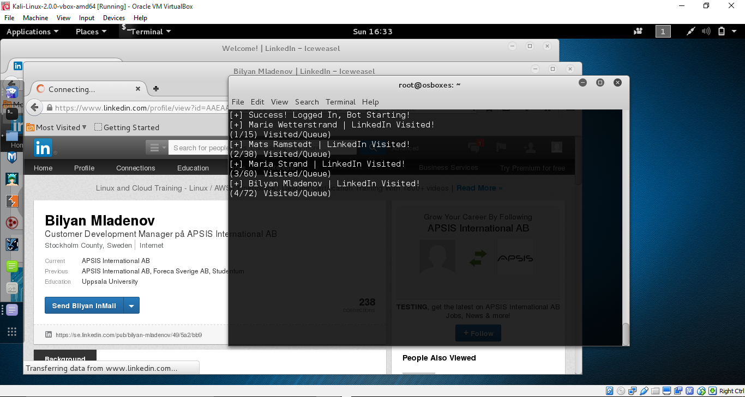
1. RESULTS-BOTNET ATTACK

Slide 13
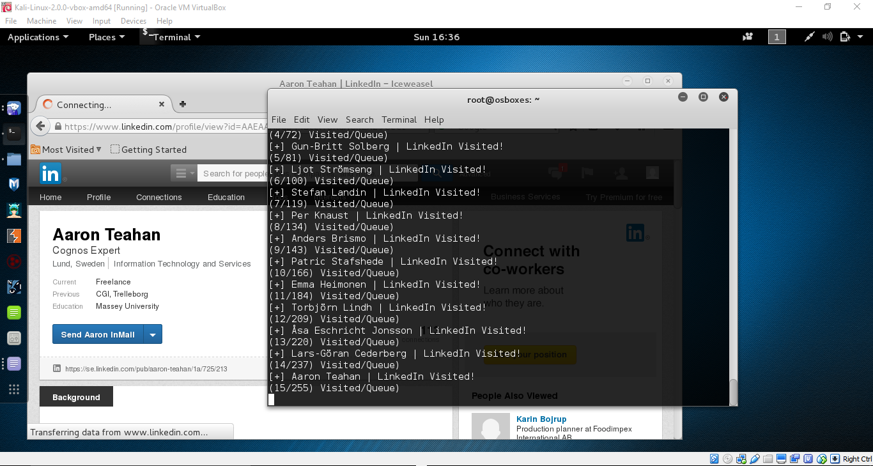

Slide 14
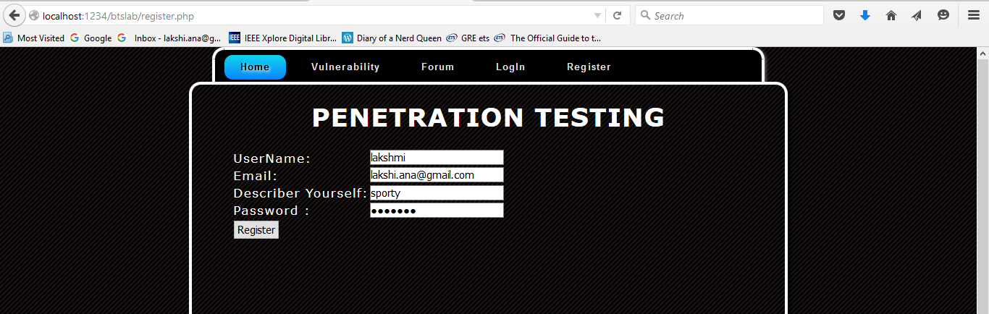
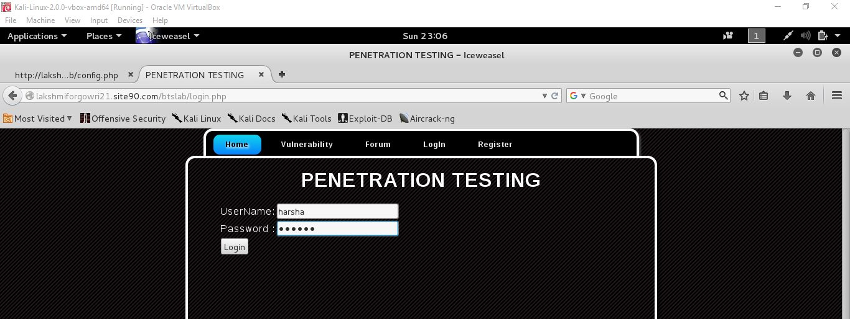
2. RESULTS-SESSION HIJACKING

Slide 15
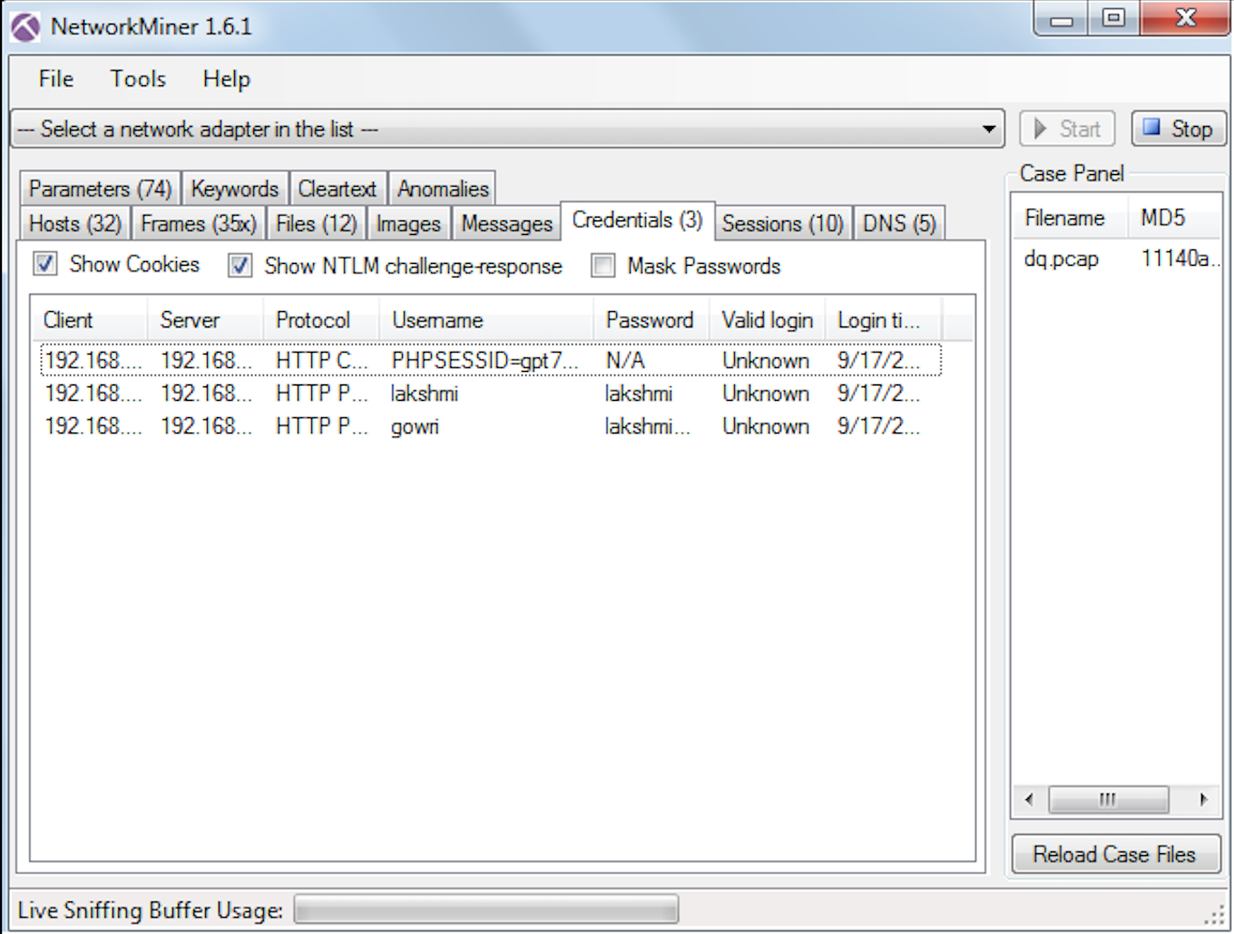

Slide 16
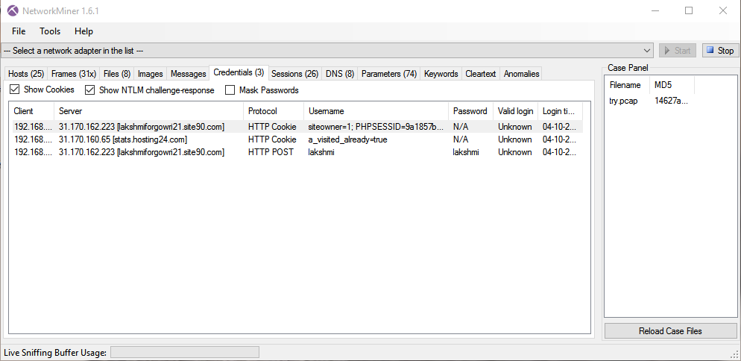

Slide 17
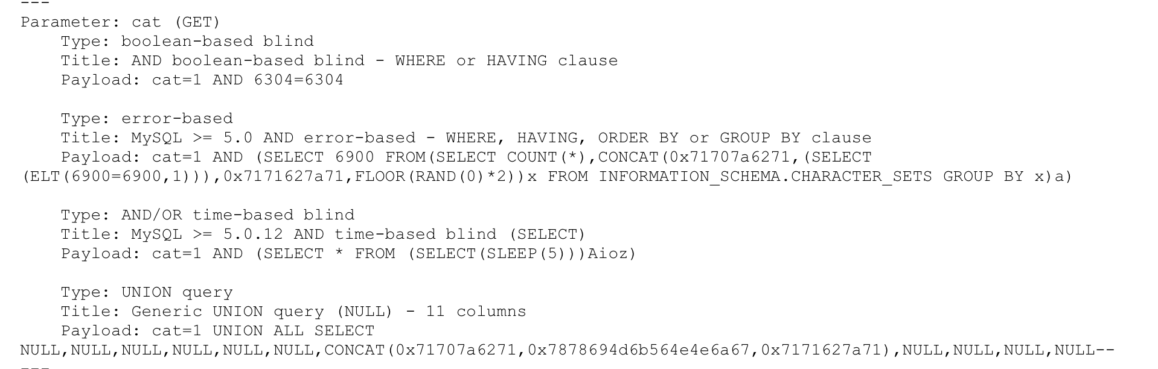
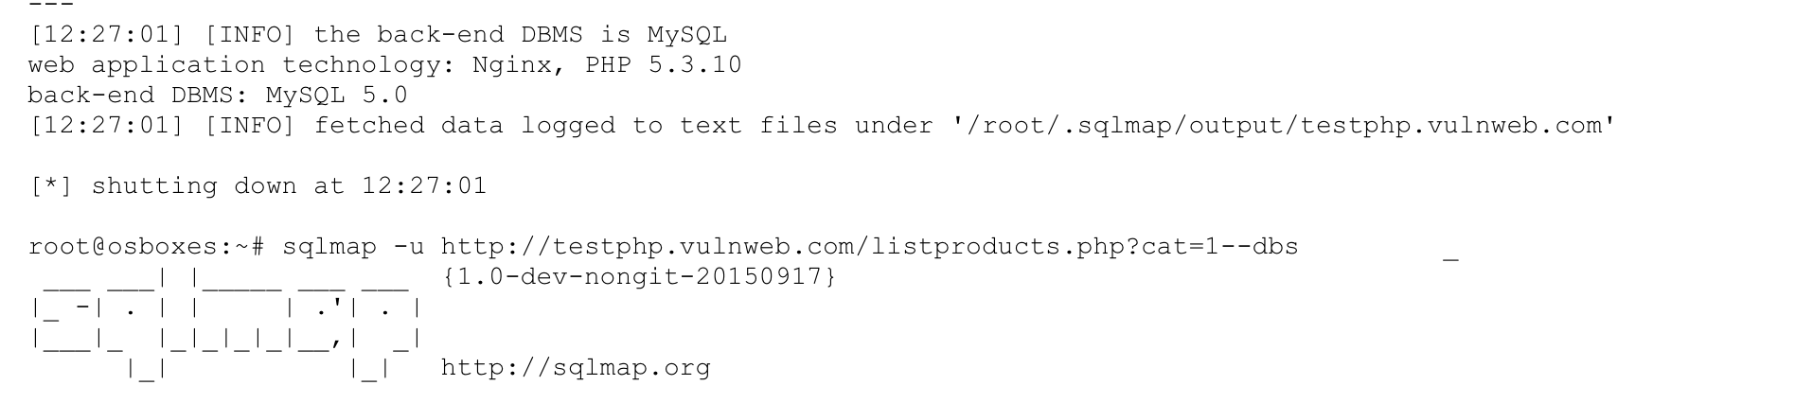
3. RESULTS-SQLMAP FOR SQL INJECTION

Slide 18
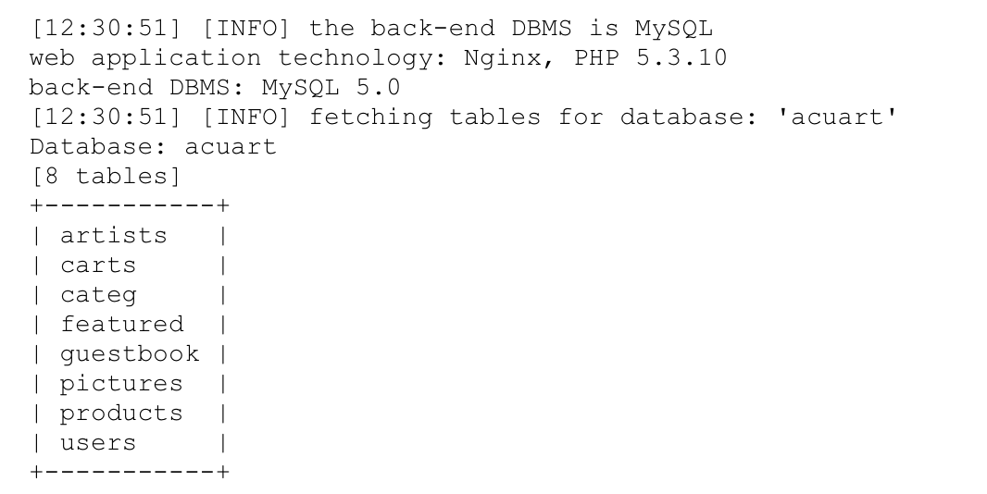

Slide 19
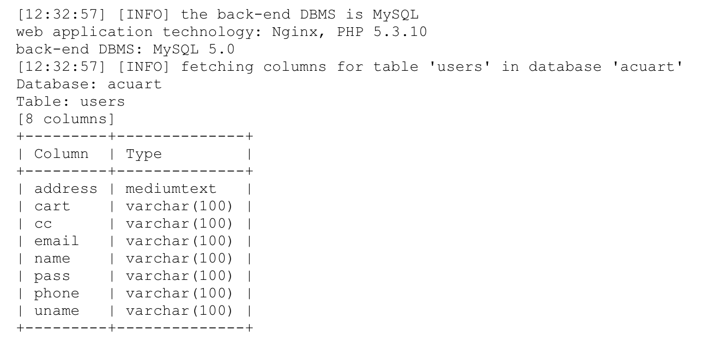
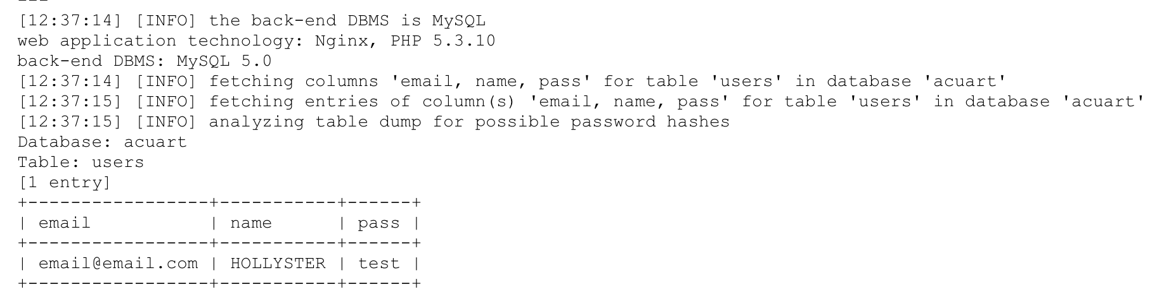

Slide 20
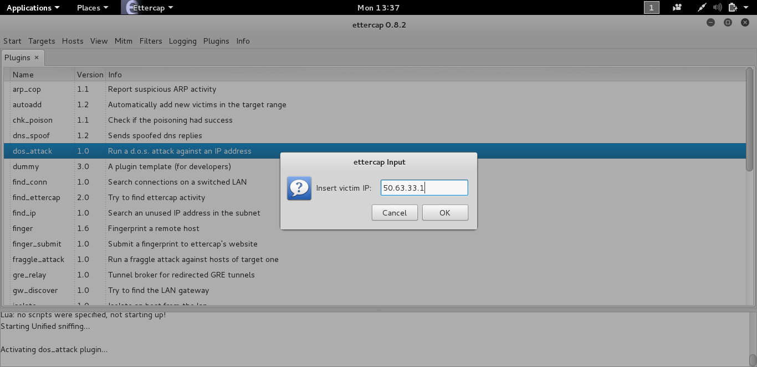
4.RESULTS-DDOS

Slide 21
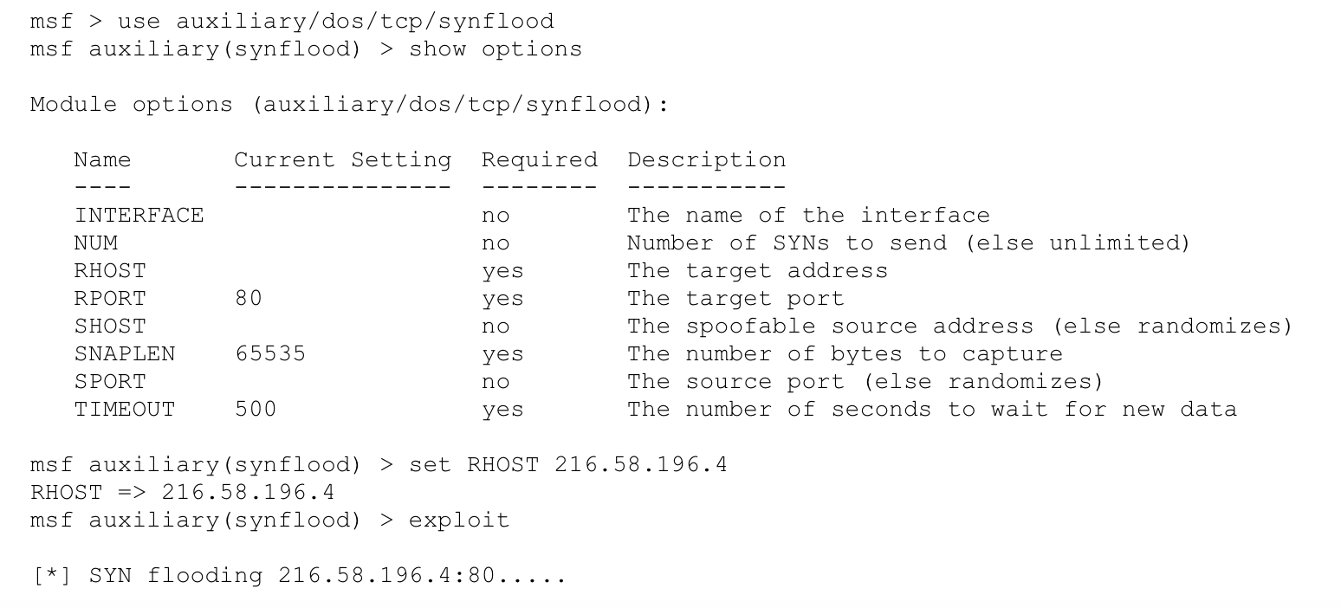

Slide 22
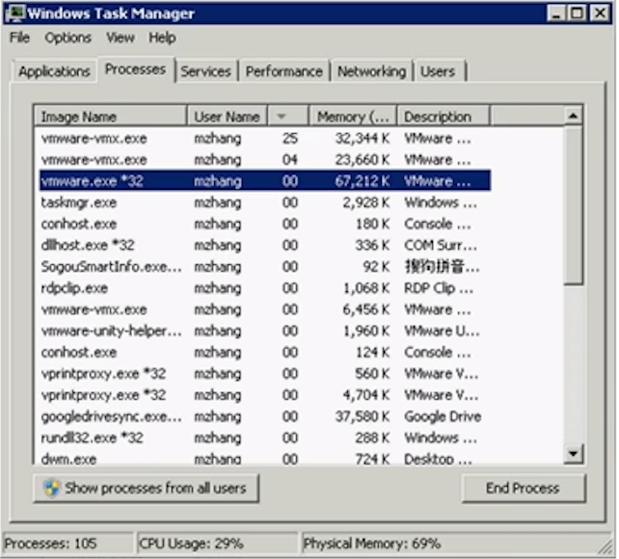
THE SCREEN FREEZES,DUE TO LOAD IN MEMORY AND CPU USAGE.

Slide 23
CONCLUSIONS
Hence we have tried to evaluate various security attacks using various tools and these are some recommendations to prevent such attacks:
Encrypting the session value will have zero effect. The session cookie is already an arbitrary value, encrypting it will just generate another arbitrary value that can be sniffed.The only real solution is HTTPS.To do that, first make sure your login page is HTTPS. When a user logs in, set a secure cookie (meaning the browser will only transmit it over an SSL link) in addition to the regular session cookie. Then, when a user visits one of your "sensitive" areas, redirect them to HTTPS, and check for the presence of that secure cookie. A real user will have it, a session hijacker will not.

Slide 24
You can prevent SQL injection if you adopt an input validation technique in which user input is authenticated against a set of defined rules for length, type and syntax and also against business rules.
Show care when using stored procedures since they are generally safe from injection. However, be careful as they can be injectable (such as via the use of exec() or concatenating arguments within the stored procedure).
DOS OR DDOS Attack can be prevented by filtering packets on router itself,configuring windows firewall,configuring web servers,setting up null routes,monitoring users,networks,malware and logs.
Botnet attacks can be prevented by installing high quality anti-malware softwares and antiviruses that can recognize patterns and prevent them from installing in the host PC.

Slide 25
REFERENCES
http://airccse.org/journal/nsa/1111nsa02.pdf
http://www.ioactive.com/pdfs/DoS-DDoS-Testing-Methodology-by-Gunter-Ollmann.pdf
http://www.ijsret.org/pdf/120272.pdf
https://www.us-cert.gov/sites/default/files/publications/Practical-SQLi-Identification.pdf
https://www.sans.org/reading-room/whitepapers/threats/byob-build-botnet-33729
http://www.academia.edu/3713854/SQL_INJECTION_ATTACKS_AND_PREVENTION_TECHNIQUES

